Slide 1
The Dollar Cost Algorithm
Contributed by
Alex Hager, Ben Morales, and Jonathan Randolph

Slide 2
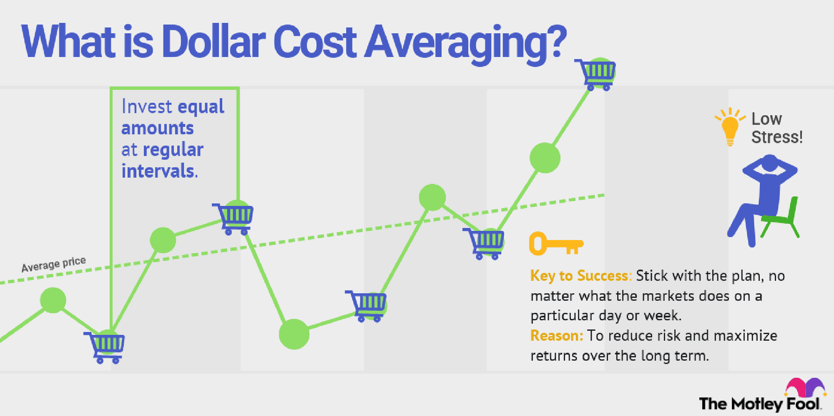
What is Dollar Cost Averaging?
Investing a fixed amount of cash into a portfolio over a set schedule

Slide 3
Investment Strategy
Principle balance $100,000
Signal 1: Monthly $500
Signal 2: 10% or greater drop in portfolio balance
Stock Portfolio
8 of the top 10 highest market cap stocks
Crypto Portfolio
6 of the top 10 highest market cap coins

Slide 4
Portfolio Breakdown
Stocks
Cryptocurrencies
Facebook (FB)
Tesla (TSLA)
Google (GOOG)
Apple (APPL)
Berkshire Hathaway (BRK.B)
Amazon (AMZN)
Microsoft (MSFT)
JP Morgan (JMP)
Stellar XLM
Solana SOL
Litecoin LTC
Ethereum ETH
Chain link LINK
Bitcoin BTC
Polkadot DOT

Slide 5
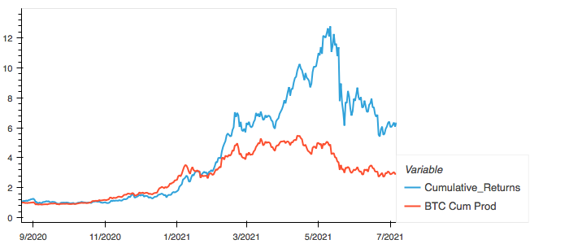
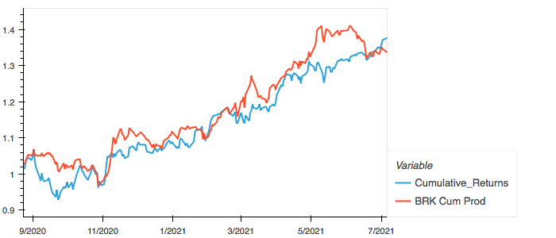
Results
Stock*
Crypto
Ending Principal : $107,000
Cumulative Return: $137,658
*Calculated without the inclusion of APPL and TSLA*
Ending Principal: $145,000
Cumulative Return: $679,049

Slide 6
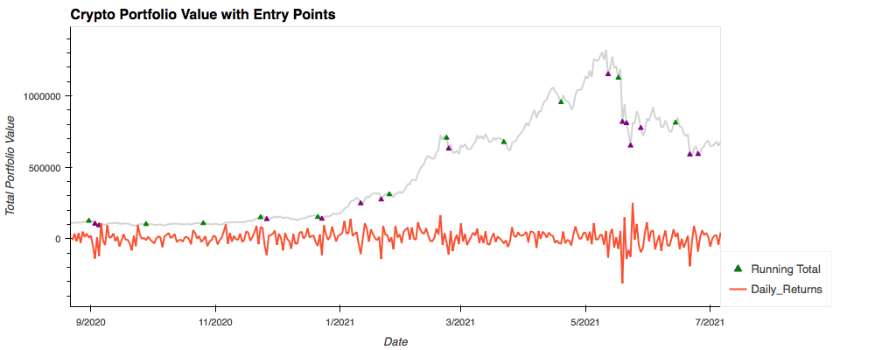
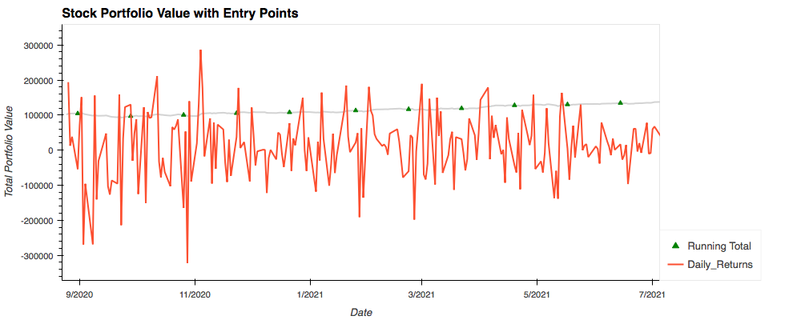
Conclusion
Algorithm is Crypto ready…to a point
To run against the Stock data successfully further logic is needed structured around fractional share size
Possibility of a combined portfolio exists.

